Slide 1
Production Models,
Age-structured Models,
and Size-Structured Models
Fish 558; Day1: 16h00-17h30
Notes:
a

Slide 2
Estimation Methods (Overview)
Age
structure
Spatial
structure
Lumped
models
Size
structure
Trophic
interactions

Slide 3
Estimation
(Desired Outputs)
Stock size (spawning biomass, exploitable biomass).
Reference points (B_{MSY}, B₀, 0.2B₀).
Age-, size-structure of the population.

Slide 4
Estimation
(Typical inputs)
Biological parameters:
  Natural mortality, M.
  Growth curve (length-age, weight-length).
  Fecundity.
  Selectivity.
Monitoring data:
  Catch.
  Fishery-dependent (catch-rates; catch-at-age; catch-at-length – by fleet).
  Fishery-independent (survey indices; survey catch-at-age; tagging).

Slide 5
Estimation
(Basic Principles)
Specify a model of the population dynamics (age, sex, size, space, ….), i.e. the equations.
Identify the data which could be used to determine the parameters of the model:
  Data to determine biological parameters (growth, fecundity, etc.) – generally used “outside” the model.
  Data to determine the rest of the parameters – included in the likelihood function.
Construct a likelihood function for the second category of data.
Minimize the negative of the logarithm of the likelihood function (and evaluate fit diagnostics).

Slide 6
Estimation
(Specifying models)
All models have four components:
  Basic dynamics – how do I get from this year to next year?
  Recruitment / growth – how do I balance the impact of losses to natural mortality?
  Catches – how do the catches impact the dynamics of the population?
  Initial conditions – what was the state of the population when my model started?
Note that some of these components (e.g. catches) may be very simple for some models. However, they must all be there somewhere.

Slide 7
Production Models –I
(The basics)
Applicable when:
  No information is available on the biological characteristics of the population (M, growth, etc.)
  All fleets have essentially the same selectivity pattern.

Slide 8
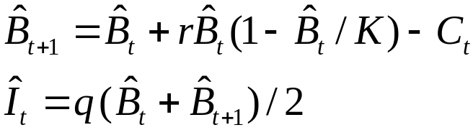
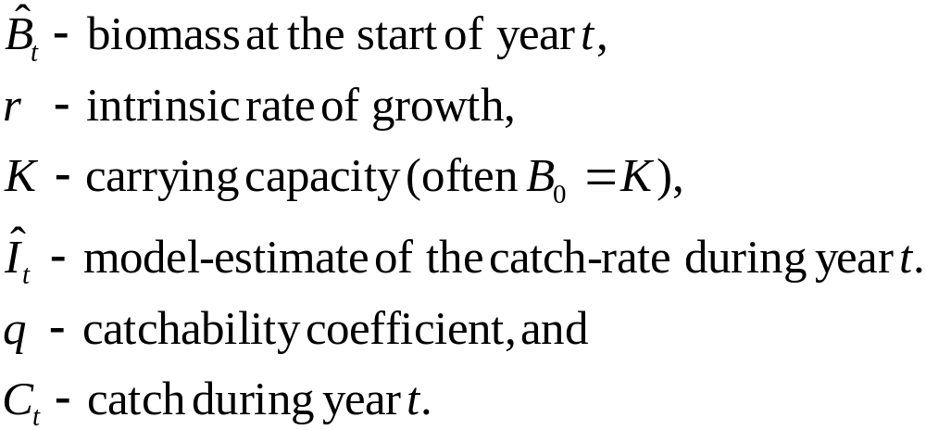
Production Models –II
(The equations)

Slide 9
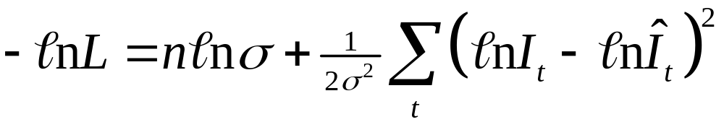
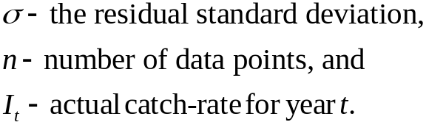
Production Models –III
(The negative log-likelihood)

Slide 10
Production Models –IV
(Advantages and disadvantages)
Advantages:
  Simple, quick, nice for homework assignments!
  B_{MSY} is calculated easily.
Disadvantages:
  Information on growth, catch-at-length, etc. are usually available for any species for which a reliable index of abundance is available.
  Relies on the assumption that selectivity is the same for all fleets.

Slide 11
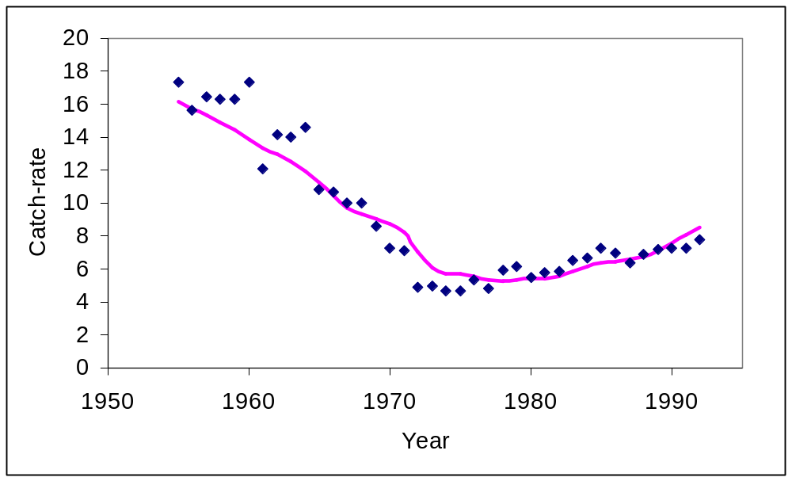
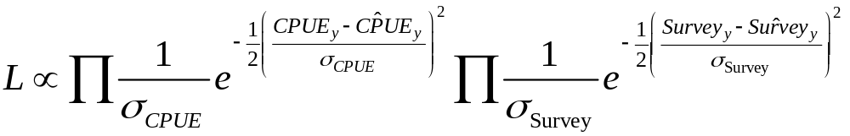
Production Models –V
(Application to Cape Hake)
Two indices of abundance (catch-rates and surveys). The likelihood function is therefore:

Slide 12
Age-structured models
(The basics)
Applicable when:
  A growth curve (and its uncertainty) is available.
  Some age- or size-composition data are available.
  The fleets each have different selectivity patterns.
Hierarchy of age-structured models:
  Backwards methods: ADAPT-VPA; tuned VPA; XSA
  Forwards methods: Integrated Analysis (Synthesis, Coleriane, CASAL)

Slide 13
Age-structured models
(The equations-I)
Age-structured models are as complicated as you want to
make them. The following slides outline an age-structured model with two fleets, no sex-structure, and a Beverton-Holt stock-recruitment relationship

Slide 14
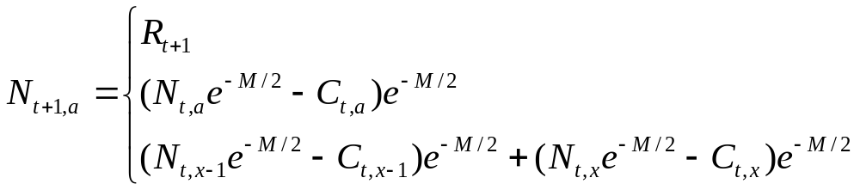
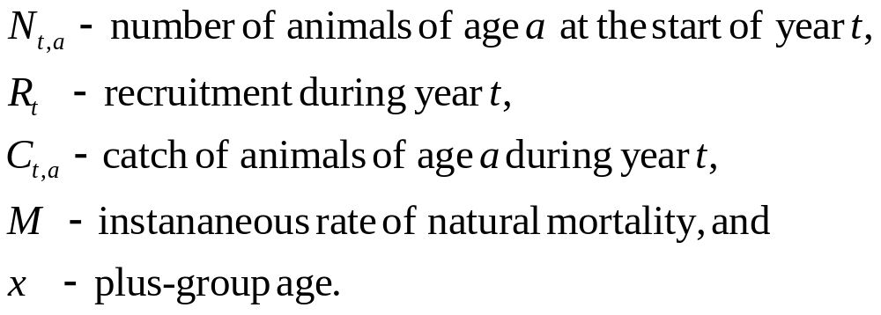
Age-structured models
(The equations-II)
Basic dynamics

Slide 15
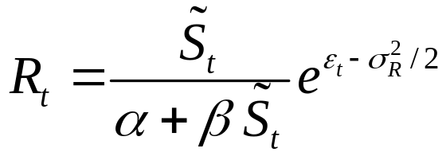
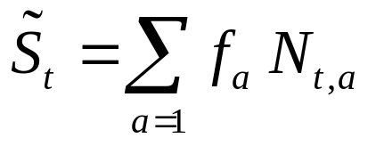
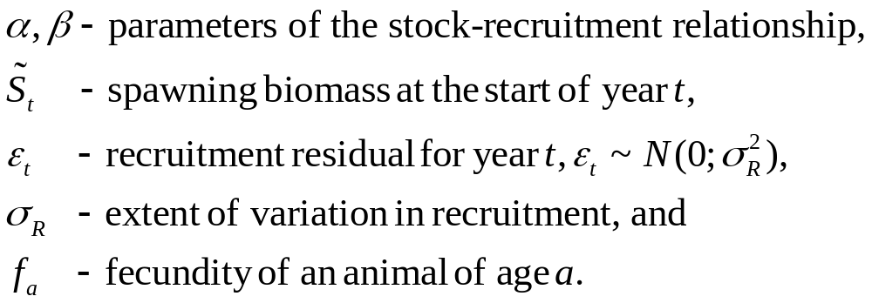
Age-structured models
(The equations-III)
Recruitment

Slide 16
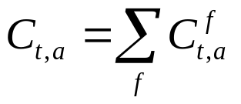

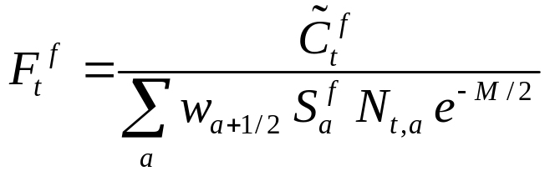
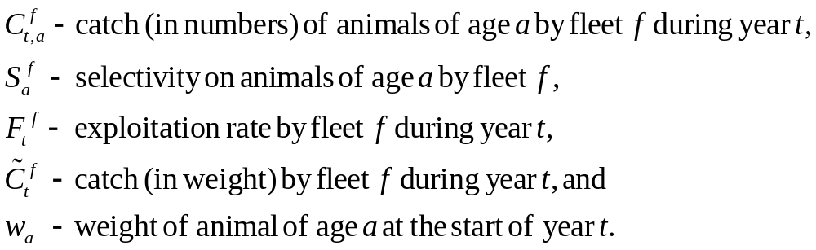
Age-structured models
(The equations-IV)
Catches

Slide 17
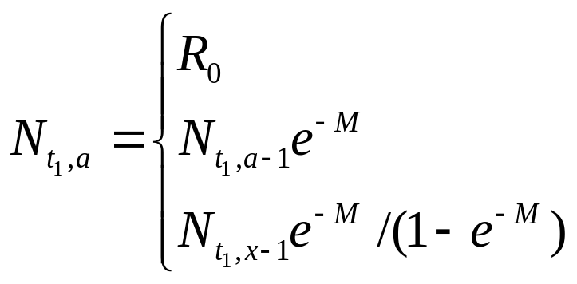
Age-structured models
(The equations-V)
Initial Conditions

Slide 18
Age-structured models
(Hints and tips on equations)
Questions arising:
  Know your assumptions - Summarize the model in terms of timing (when do things happen in the model).
  Start simple and extend as needed - How would you extend the model to allow for: a) sex-structure, b) time-varying selectivity, c) sex-change, d) a tagged population, and e) an MPA?
  The model must produce the right outputs – Does the model produce the types of outputs we need?
  Know your model parameterization – Identify the parameters of the model and how you could estimate their values?

Slide 19
Age-structured models
(The objective function-I)
The objective function is almost always case-specific (it depends on the available data). Common contributions to the objective functions include:
  indices of abundance (usually log-normal, but sometimes normal / gamma);
  catch-at-age (usually multinomial, but sometimes lognormal / robust normal);
  catch-at-length (usually multinomial, but sometimes lognormal / robust normal);
  discard data (discard rates and discard length- and age-composition information);
  length-at-age (usually normal);
  mean weight (usually normal); and
  indices of exploitation based on tagging data (??)

Slide 20
Age-structured models
(The objective function-II)
The objective function often also includes penalties (“priors”). The most typical of these are:
  a penalty on the recruitment residuals;
  a penalty on the extent to which selectivity varies from one year to the next;
  a penalty on the extent to which selectivity is domed-shape / monotonic; and
  priors on M and steepness.

Slide 21
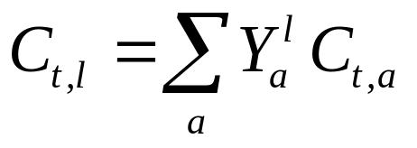
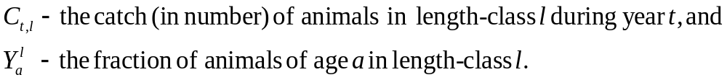
Age-structured models
(The objective function-III)
It is necessary to compute the model-estimate of the catch-
at-length when age-structured models are fitted to length-
frequency data. This is usually achieved using the formula:

Slide 22
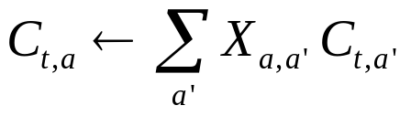
Age-structured models
(The objective function-IV)
Account can be taken of age-reading error using an
age-reading error matrix, viz:

Slide 23
Age-structured models
(Advantages and disadvantages)
Advantages:
  Far more flexibility to include realistic population dynamic processes and data in analyses.
Disadvantages:
  More complicated (mathematically and computationally) than age-lumped models.
  Flexibility makes it hard to decide “when to stop”.

Slide 24
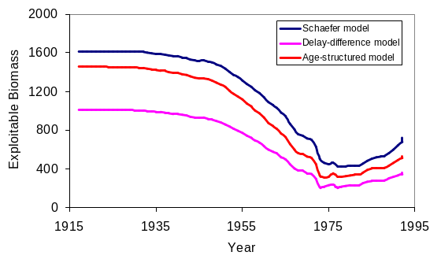
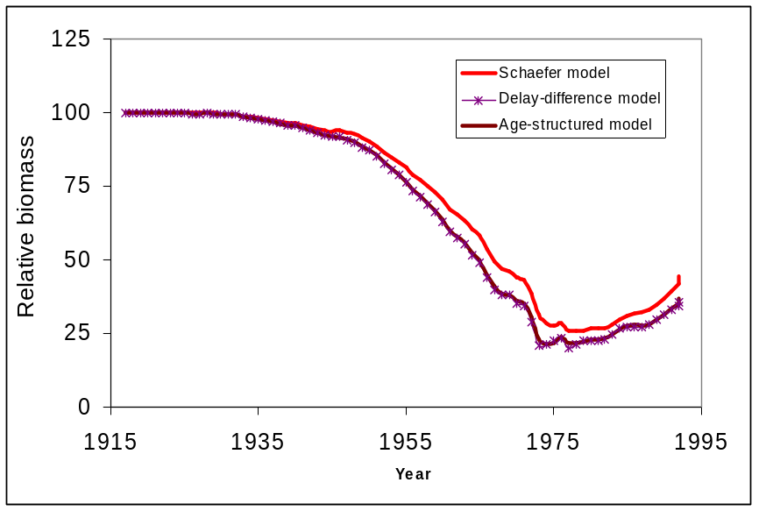
Age-structured models
(Application to Cape hake)
Results of fitting a deterministic
age-structured model to catch-rate
and survey data for Cape hake
AIC suggests that the production
model fits the data best!

Slide 25
Size-structured models
(The basics)
Applicable when:
  Animals cannot be aged / the growth curve is indeterminate (i.e. t₀ cannot be determined).
  The primary source of data is length-composition information.
Hierarchy of size-structured models:
  Various “data-poor” size-based methods of stock assessment exist – most are very biased.
  The size-structured models outlined here are based on the “Integrated Analysis” paradigm.

Slide 26
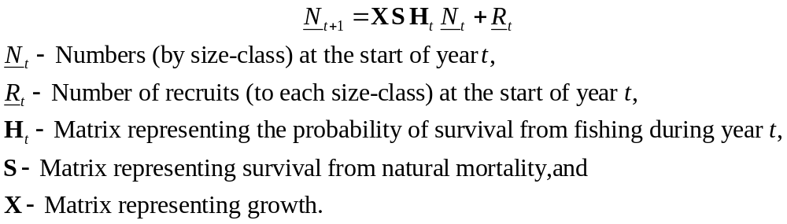
Size-structured models
(The equations)
Size-structured models are constructed in the same way as age-structured models, except that the basic dynamics are size- rather age-structured, i.e.:

Slide 27
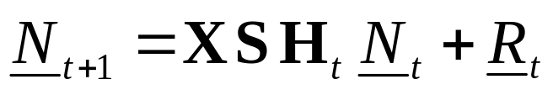
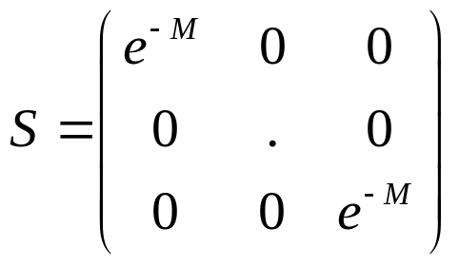
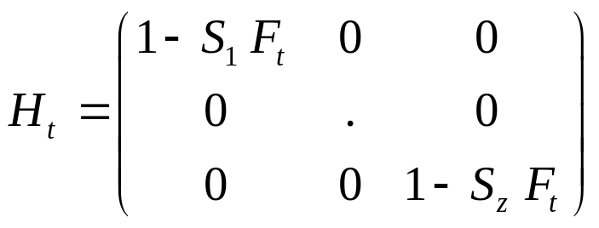
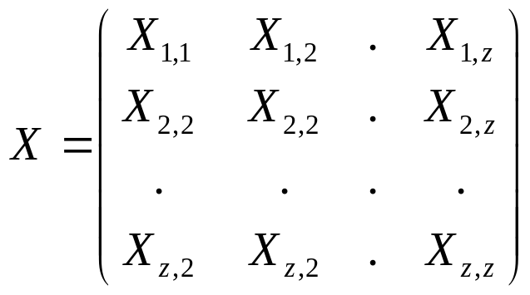
Size-structured models
( expanded)
Natural survival
Harvest survival
Growth
The matrix X is often constrained to prevent “negative growth” (e.g. lobsters, abalone)

